Slide 1
Sorting

Slide 2
Sorting
A Sorting Algorithm is used to rearrange a given array or list elements in either in increasing (ascending) or decreasing (descending) order.
For example
1:
Input: 56 23 11 28 48
Output: 11 23 28 48 56
2:
Input: r e w b o
Output: b e o r w

Slide 3
Types of sorting techniques
Bubble sort,
Selection sort,
Insertion sort,
Merge sort,
Quick sort,
Radix sort,
Tim sort

Slide 4
Bubble Sort

Slide 5
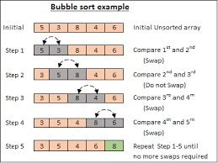

Slide 6
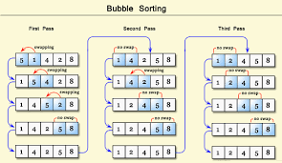
Bubble Sort

Slide 7
Algorithm

Slide 8
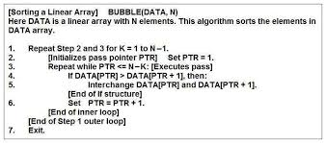
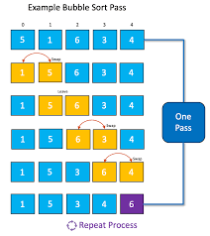

Slide 9
Complexity
Best Case - Ω(n)
Average Case – θ(n^2)
Worst Case – O(n^2)

Slide 10
Implementation
#include <stdio.h>
void main()
{
int a[10], n, i, j, temp;
printf("\n Enter number of elements: ");
scanf("%d", &n);
printf("\n Enter %d integers\n", n);
for (i = 0; i < n; i++)
scanf("%d", &a[i]);
for (i = 0 ; i < n - 1; i++)
{
for (j = 0 ; j < n - i - 1; j++)
{
if (a[j] > a[j+1])
{
temp = a[j];
a[j] = a[j+1];
a[j+1] = temp;
}
}
}
printf("Sorted list in ascending order:\n");
for (j = 0; j < n; j++)
printf("%d ", a[j]); return 0;
}

Slide 11
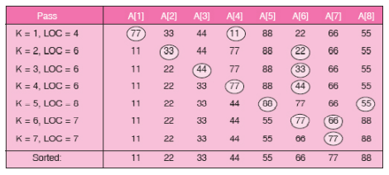
Selection Sort

Slide 12
Algorithm

Slide 13
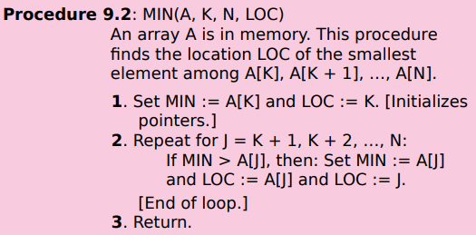
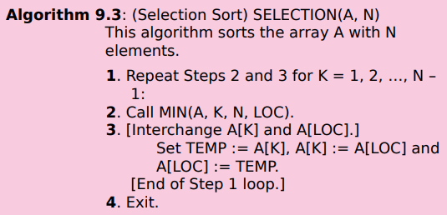

Slide 14
Complexity
Best Case - Ω(n^2)
Average Case – θ(n^2)
Worst Case – O(n^2)

Slide 15
Implementation

Slide 16
#include <stdio.h>
void main()
{
int arr[10]={6,12,0,18,11,99,55,45,34,2};
int n=10, i, j, position, swap;
for (i = 0; i < (n - 1); i++)
{
position = i;
for (j = i + 1; j < n; j++)
{
if (arr[position] > arr[j])
position = j;
}
if (position != i)
{
swap = arr[i];
arr[i] = arr[position];
arr[position] = swap;
}
}
for (i = 0; i < n; i++)
printf("%d\t", arr[i]);
}

Slide 17
Insertion Sort

Slide 18
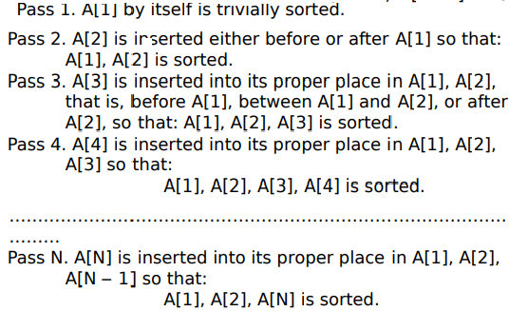

Slide 19
Example

Slide 20
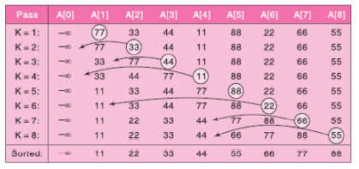

Slide 21
Algorithm

Slide 22
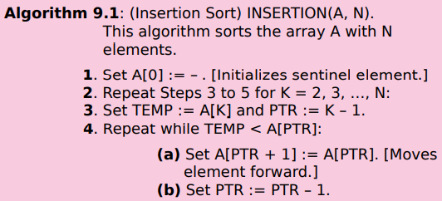
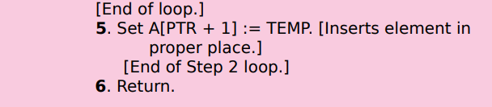

Slide 23

Complexity

Slide 24
Merge Sort

Slide 25
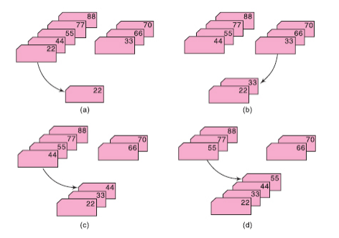

Slide 26
Algorithm

Slide 27
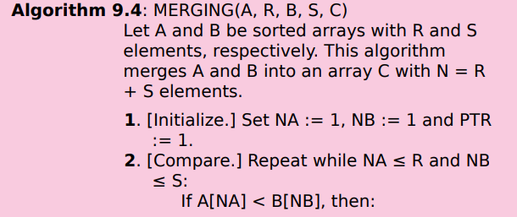
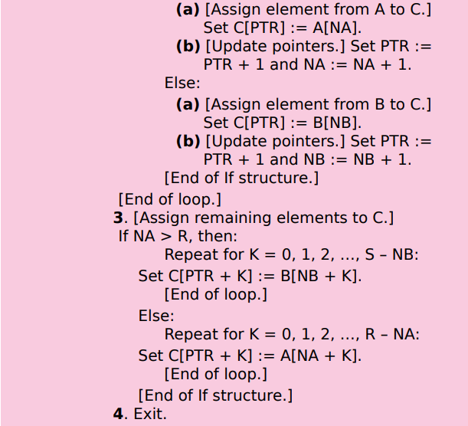

Slide 28
Radix Sort

Slide 29
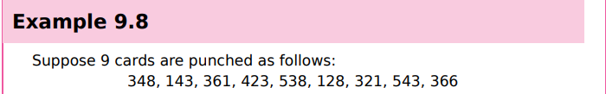

Slide 30
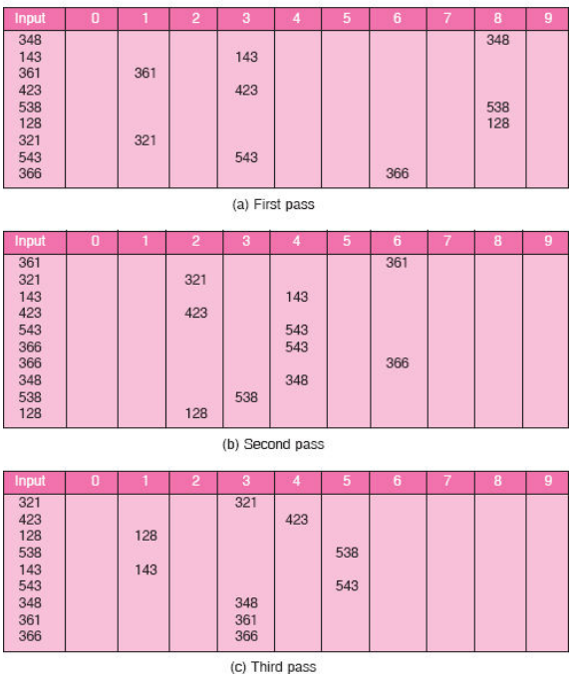

Slide 31
Complexity
Worst case – O(n2)
Best case – O(n log n)

Slide 32
Drawback:
It perform well only when the number passes of digits in the representation of the A is small.
2. It needs d*n memory locations.

Slide 33
Examples
23 67 45 90 64 32 18 28
4563 2134 2178 5643 1220 3980 5123

Slide 34
Quick sort
Example:
44, 33, 11, 55, 77, 90, 40, 60, 99, 22, 88, 66

Slide 35
Prerequisite
Recursion
Stack

Slide 36
Algorithm

Slide 37
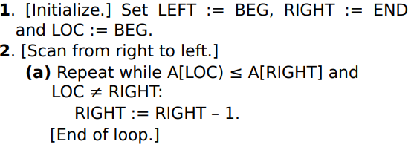
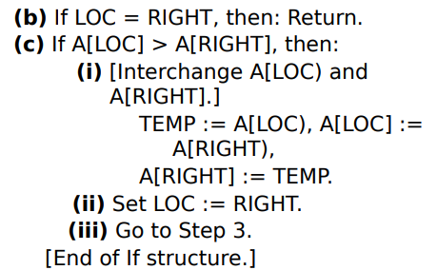
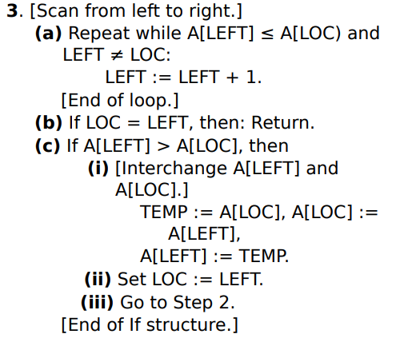

Slide 38
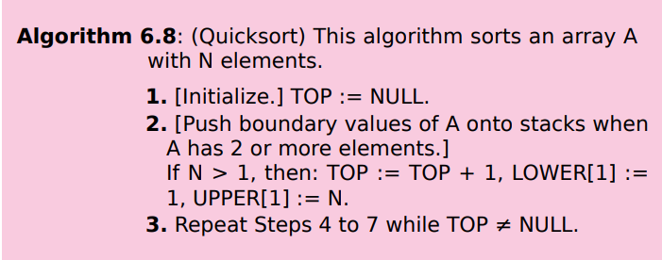
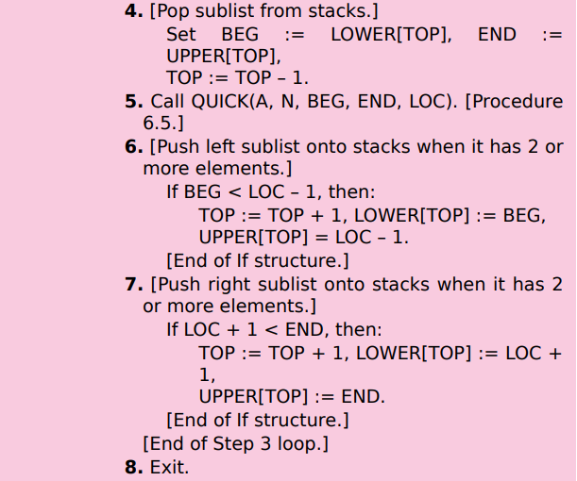

Slide 39
Complexity
Best case- n log n
Average case- n log n
Worst Case – n2

Slide 40
Tim Sort

Slide 41
Tim Sort
-derived from insertion sort and merge sort.
-perform in an optimal way on different kind of real world data.
-needs O(n log n) comparisons to sort an array of n elements.
-designed and implemented by Tim Peters in 2002 in python programming language.
-array is divided into several parts where each of them is called a Run.
-Runs are sorted by using insertion sort one by one and then the sorted runs get combined using merging.

Slide 42
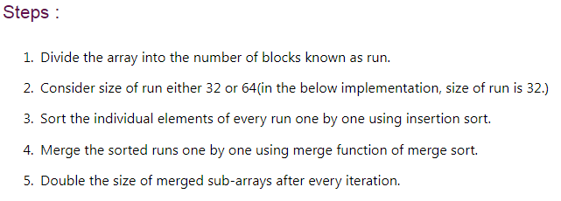

Slide 43
Example
23 89 56 30 45 29 65 32 12 41 68 52 19 34 88 25 34 56 44 11
Run 1
Run 2
Run 3
Run 4

Slide 44
Procedure: minimum(a, b)
This procedure find minimum number between two numbers
If a < b, then: return a.
Else: return b.
[End of If structure]
Algorithm: TIMSORT(A,N)
This algorithm sort the N-element array A.
1.[Initialize]Set run=32, i=0
2. Repeat while i < n
a. Call insertionsort (a, i, minimum((i+31),(n-1))).
b. Set i+=run.
[End of step 2 loop]
3. Set size = run
4. Repeat while size < n
a. Set beg=0
b. Repeat while beg<n
i. mid= beg+size-1
ii. end=minimum((beg+2*size-1),(n-1))
iii. Call merge(a,big,mid,end));
iv. beg+=2*size
[End of while loop]
c. size=2*size
[End of Step 4 loop]

Slide 45
